Slide 1


Ranking Web Pages with Math

Slide 2
The Problem
There are millions of web pages.
How can we decide which pages are more important?
Not all links are equal — PageRank solves this!

Slide 3
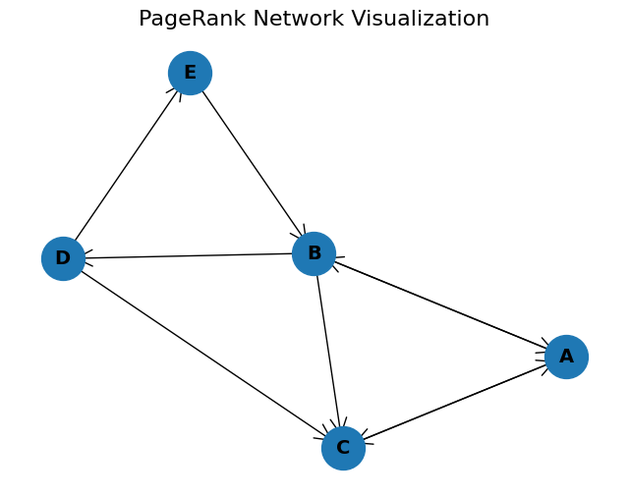
Sample Network
Each arrow is a link from one page to another.
We’ll use this small network to understand PageRank.

Slide 4
The Connections
Page A → B, C
Page B → A, C, D
Page C → A
Page D → C, E
Page E → B

Slide 5
Representation as a Matrix
0 | 1 | 1 | 0 | 0
1 | 0 | 0 | 0 | 1
1 | 1 | 0 | 1 | 0
0 | 1 | 0 | 0 | 0
0 | 0 | 0 | 1 | 0
0 | 0.33 | 1 | 0 | 0
0.5 | 0 | 0 | 0 | 1
0.5 | 0.33 | 0 | 0.5 | 0
0 | 0.33 | 0 | 0 | 0
0 | 0 | 0 | 0.5 | 0
This Matrix is then Normalized Column Wise Normalized Matrix

Slide 6
What if a page has no outgoing links?
A dangling page is one that doesn’t link to any other page
Its column in the link matrix is all zeros
It “traps” the rank — once you land on it, there’s nowhere else to go
It can cause the total PageRank to leak or break convergence
The dangling column is replaced by [1/n, 1/n, ...] where n is the size of the column
In our case, that would be [0.2, 0.2, 0.2, 0.2, 0.2]

Slide 7
The Damping Factor
Prevents users from getting stuck in loops or on dangling pages
Models realistic browsing as users sometimes jump randomly
α = 0.85 : follow a link
1−α = 0.15 : jump to a random page

Slide 8
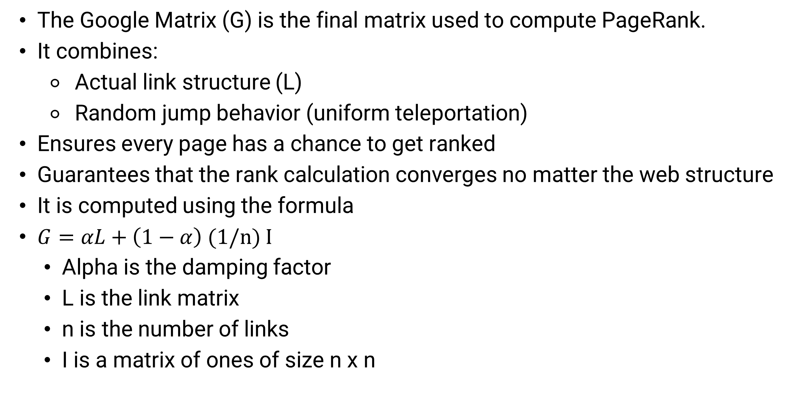
Google Matrix
The Google Matrix (G) is the final matrix used to compute PageRank.
It combines:
Actual link structure (L)
Random jump behavior (uniform teleportation)
Ensures every page has a chance to get ranked
Guarantees that the rank calculation converges no matter the web structure
It is computed using the formula
$G=αL+\left(1−α\right)$ (1/n) I
Alpha is the damping factor
L is the link matrix
n is the number of links
I is a matrix of ones of size n x n

Slide 9
Iterative Computing
We initialize r(0) as [1/n, 1/n, 1/n, ...] assuming equal ranking for all pages
Then we compute r(t+1) = G x r(t)
This process is repeated till the values converge
23 iterations were required for convergence in this case

Slide 10
Final Result
The Ranked Importance of pages after 23 iterations is
Page A – 0.3292
Page C – 0.2755
Page B – 0.2298
Page D – 0.0951
Page E – 0.0704

Slide 11
Scaling
PageRank uses matrix multiplication and power iteration
Handles millions of pages by:
Representing links as sparse matrices
Using fast convergence (usually under 100 steps)
Applying damping to stabilize results

Slide 12
Conclusion
PageRank ranks pages by network influence, not just link count
Uses matrix iteration with a damping factor for realism
Simple idea, powerful math, real-world impact
Still used in search, recommendations, and network science

Slide 13
THANK YOU
Presented by

